Slide 1
exception handling
Exceptions are a type of error that occurs during the execution of an application. Typically, problems that are not anticipated result in errors, whereas the application’s code intentionally foresees exceptions due to various reasons.
Applications use exception handling logic to explicitly handle the exceptions when they happen. Exceptions can occur for a wide variety of reasons

Slide 2
Exceptions allow an application to transfer control from one part of the code to another. When an exception occurs
try – A try block encloses a section of code. When code throws an exception within this block, the corresponding catch handles the exception
catch – When an exception happens, the code within the Catch block executes. This is where you are able to handle the exception, log it, or ignore it
finally – The finally block enables the execution of specific code irrespective of exception. For instance, it facilitates the disposal of an object that requires disposal
throw – The throw keyword crafts a fresh exception, ascending to a try-catch-finally block

Slide 3
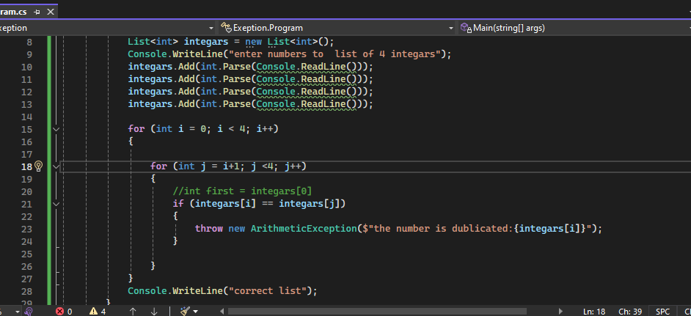

Slide 4
